Slide 1
Managed Forest Council is the independent public regulator of forest practices protecting key environmental values under the Private Managed Forest Land Act
Notes:
I appreciate the opportunity to come and talk to today
In 2004 government enacted the Private Managed Forest Land Act to protect key environmental values on private managed forest land
The Act establishes the Managed Forest Council as the authority to enact and enforce regulations respecting forest practices on private managed forest land

Slide 2
WHO IS THE COUNCIL?
Rod Davis
Chair
Council
Phil O’Connor
Executive Director
Blair Robertson
Vice-Chair
Brian Frenkel
Dennis Lozinski
Will Pryhitko
Ann Donaldson
Program Manager
Resource Specialists
Foresters
Geoscientists
Biologists
Administrative Specialists
Legal Counsel
Communications
Financial Services
Notes:
Council consists of 5 members
2 members are appointed by the provincial government and 2 are elected by the landowners
The chair is appointed by the other four members as the fifth independent member of council
The Council maintains a small staff and is managed by an Executive Director
The Council contracts a range of professionals to conduct field inspections, audits and investigations, as well as a range of legal and administrative services

Slide 3
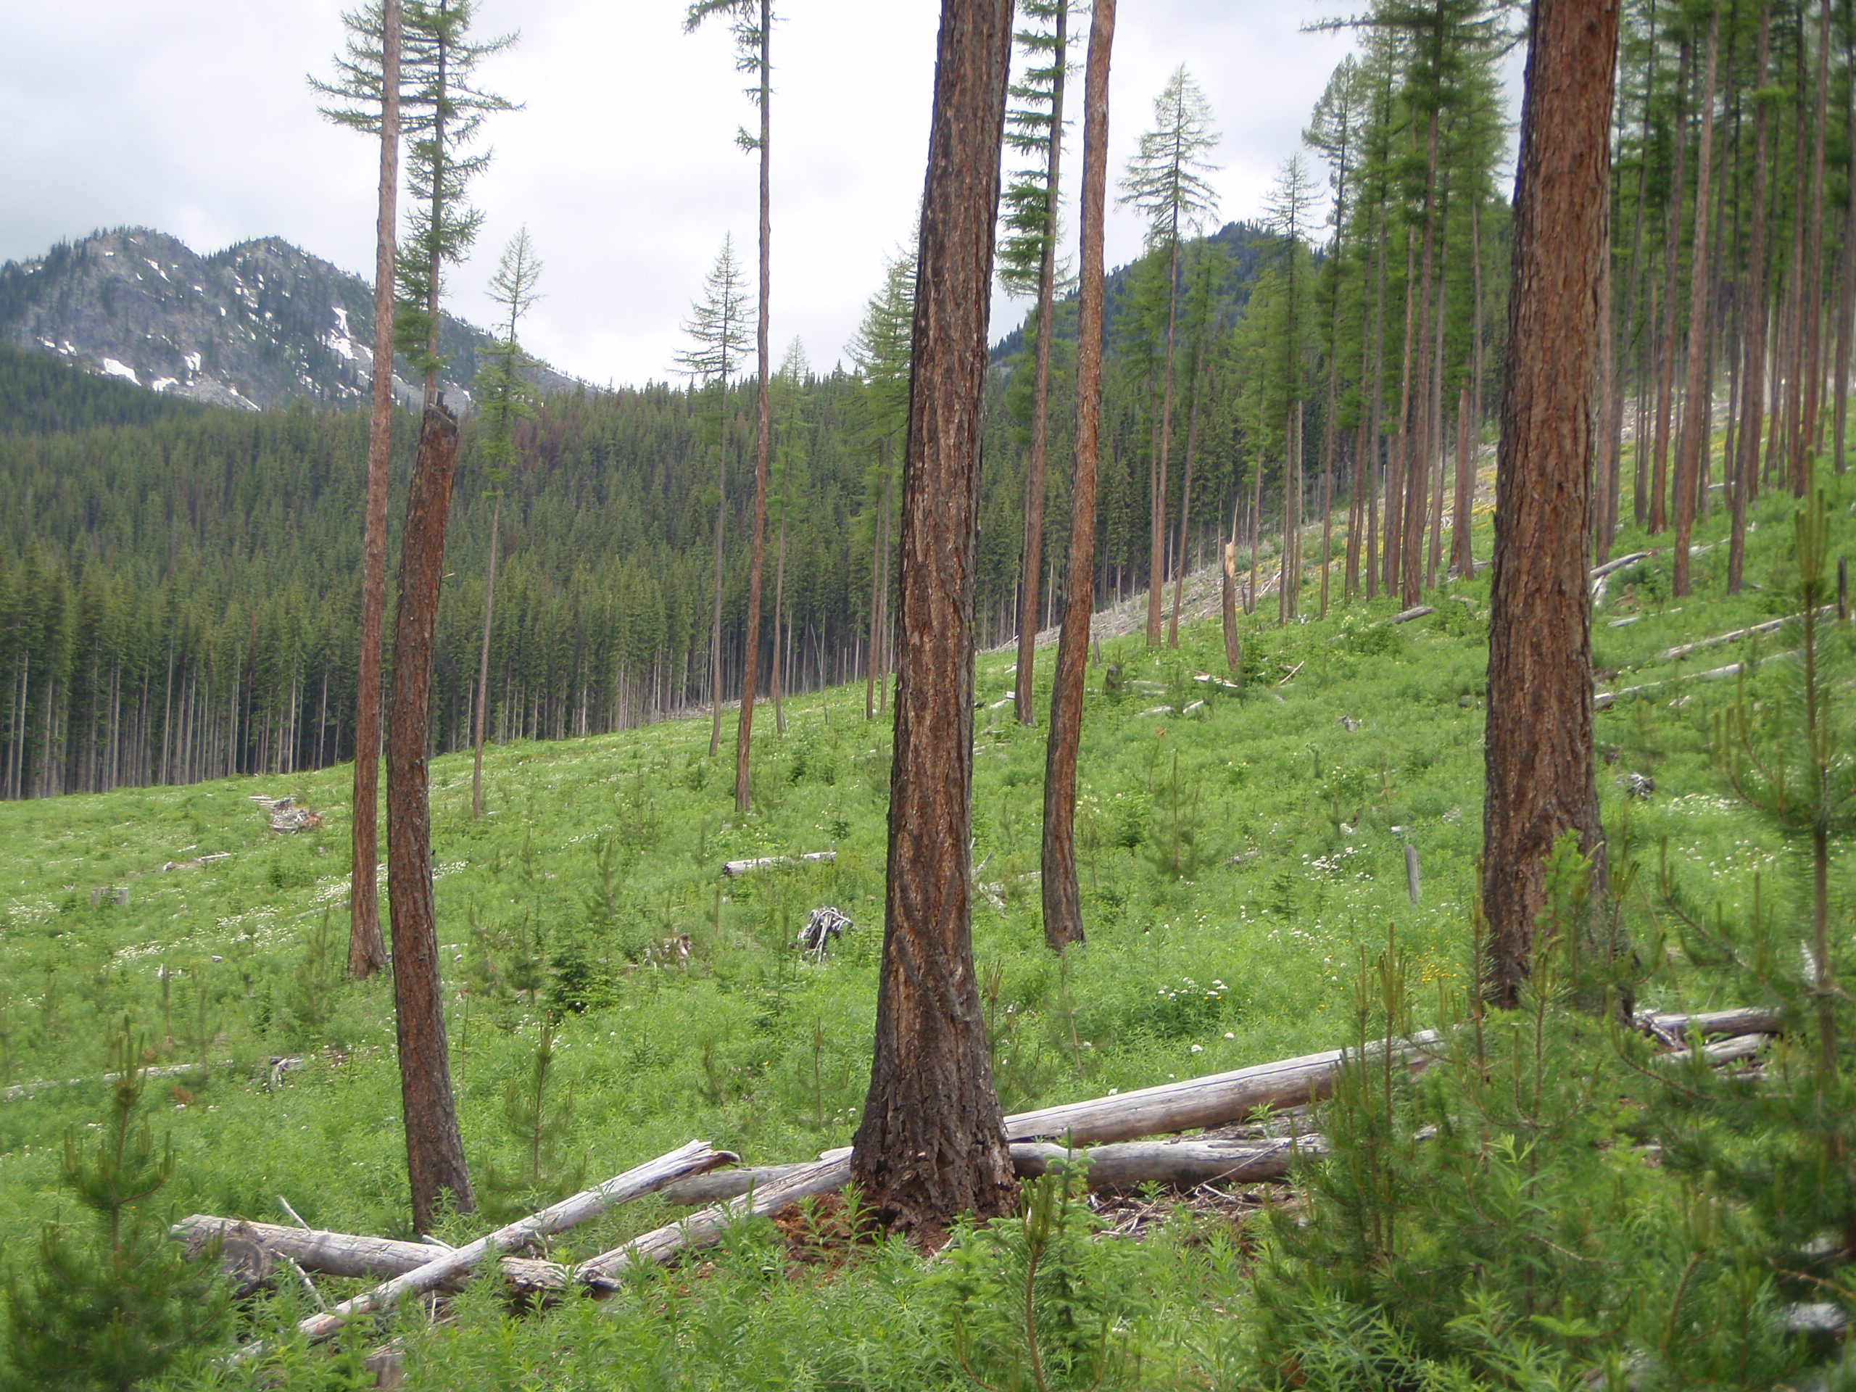
What is Council’s mandate?
Notes:
We are empowered to make and enforce regulations encouraging sustainable forest management and protecting key environmental values on private managed forest land
Council enforces the regulations and we can assign penalties, make remediation orders, enter into consent agreements, revoke status for landowners and issue stop work orders
In fulfilling these roles we:
conduct inspections, audits and investigations of landowners operations,
review applications from landowners to enter and exit managed forest land status,
review annual declarations from owners

Slide 4
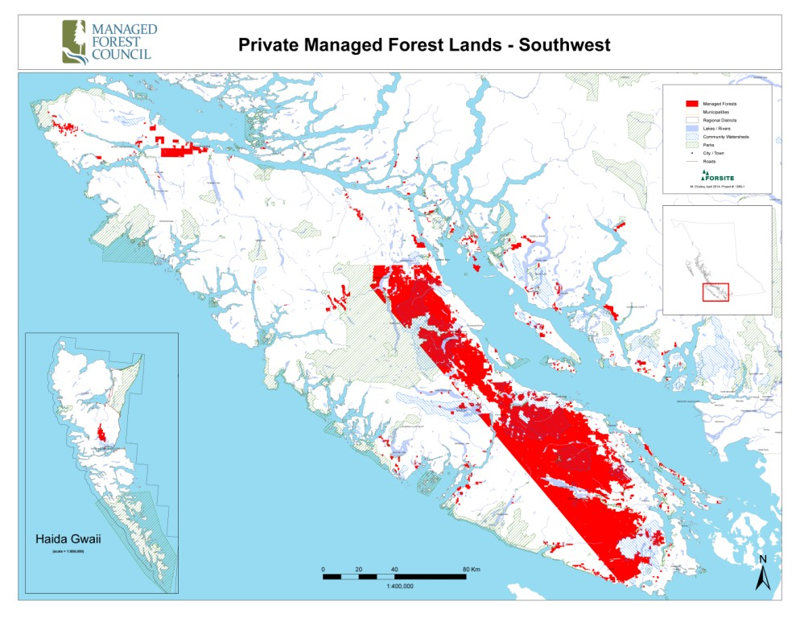
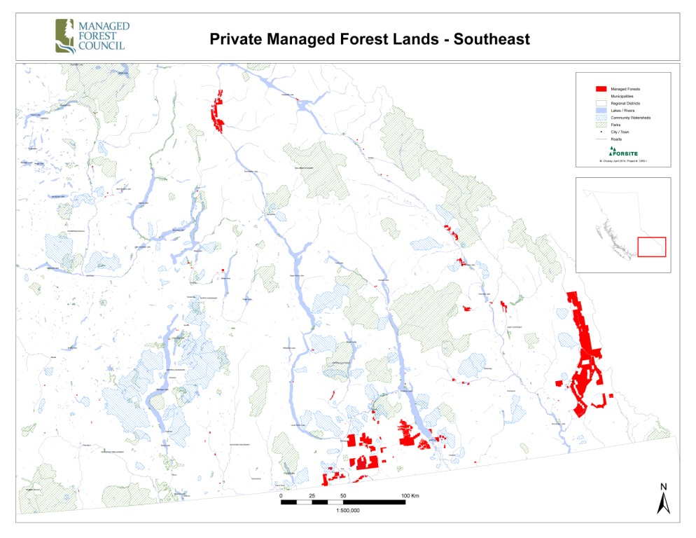
WHERE IS MANAGED FOREST LAND LOCATED?
Notes:
Currently there are 278 managed forests in the province on 818,000 ha.
Properties are located mostly on Vancouver Island (~70%) and the Kootenays (~20%), ~10% is distributed across the province
They range in size from 2.1 ha to 165,000 ha
4.7 million cu. meters harvested in 2017-18
representing approximately 7% of the total provincial timber harvest and 28% of the timber harvest on the Coast.

Slide 5





WHAT ARE THE 5 KEY RESOURCE OBJECTIVES OF THE MANAGED FOREST PROGRAM?
Protect soil productivity
Protect drinking water
Protect fish habitat
Protect critical wildlife habitat
Forest regeneration
Notes:
The Private Managed Forest Land Act sets out 5 key management objectives aimed at sustainable forest management practices and protection of key environmental values
Landowners must protect soil productivity by minimizing the area occupied by roads, landing and trails
They must protect human drinking water and fish habitat both during and after harvesting
They must provide opportunities for the Ministry of Environment to assess critical wildlife habitat and work with the Ministry to protect critical wildlife.
They must restock and successfully regenerate harvested / destroyed areas within an established regulatory timeframe

Slide 6
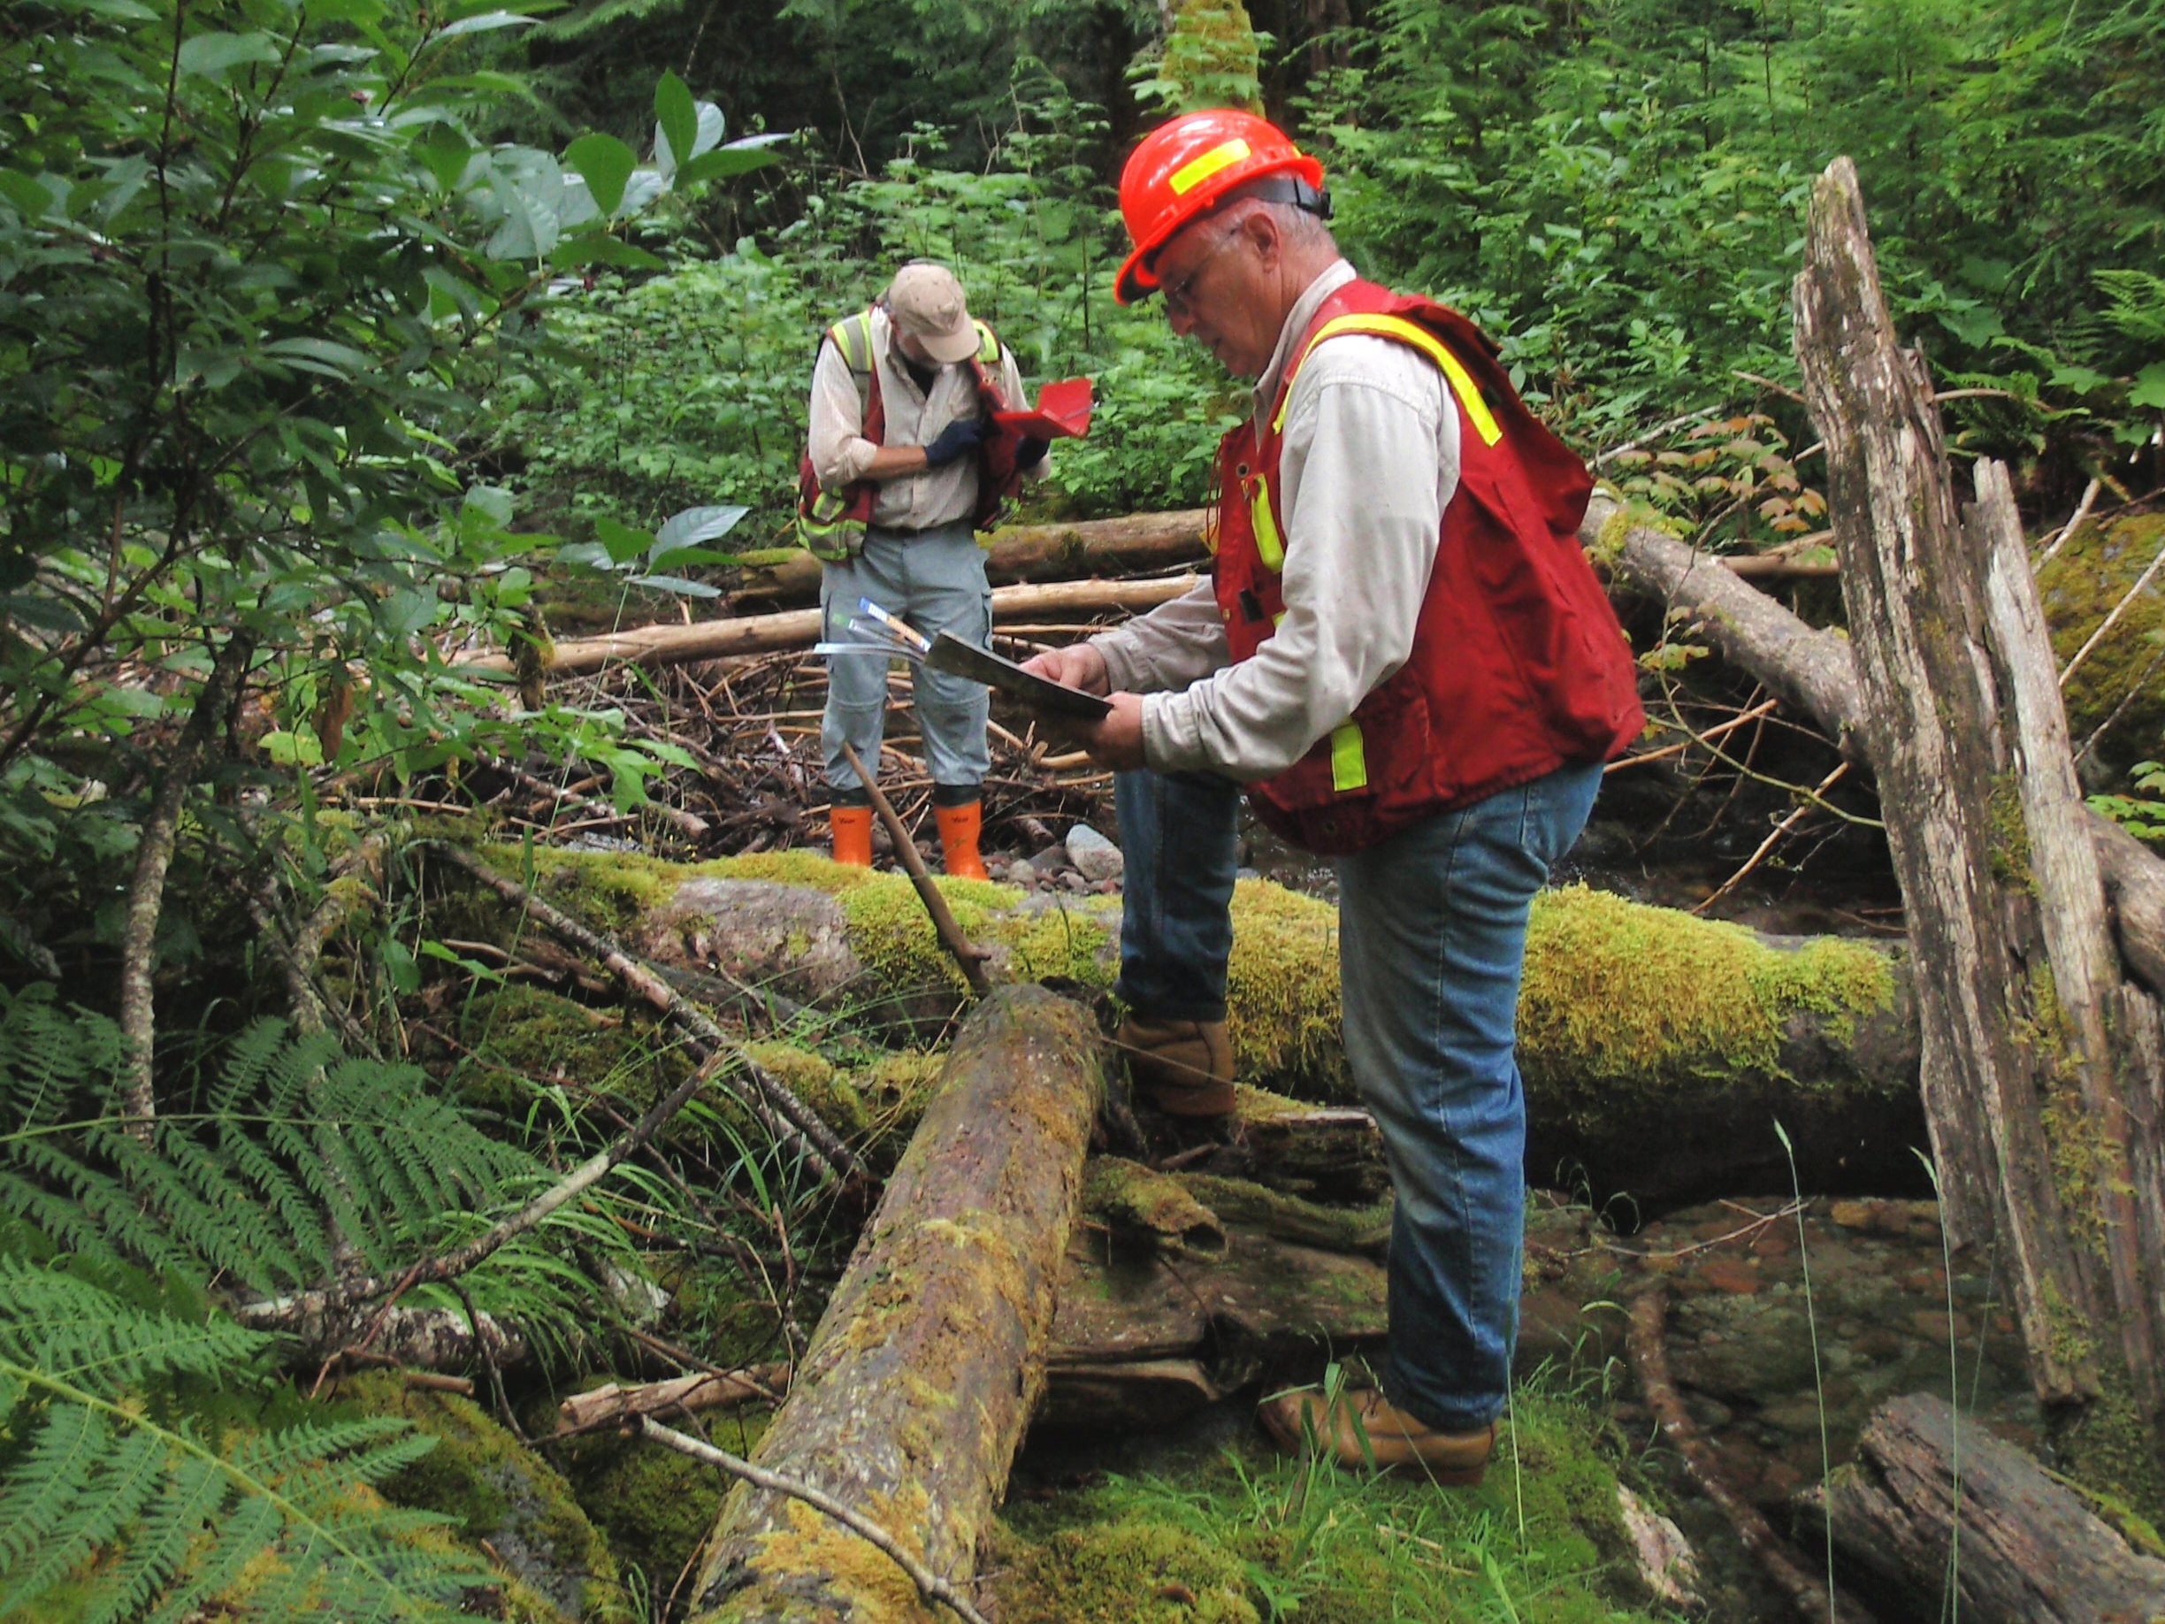
How does Council know landowners are complying with regulations?
Notes:
Regulatory requirements are binding on owners, employees and contractors
Compliance is determined through our inspection program, public or stakeholder complaints, an audit, or mandatory self-reporting of a slide by the owner
Our policy is to inspect all managed forests at least once every 5 years – that’s 20% of managed forests each year
Some managed forests are inspected more frequently based on past performance and environmental risk
New managed forests are inspected within 3 years
Inspections reveal a high rate of compliance by landowners, where an inspection or complaint indicates potential noncompliance, council initiates a formal investigation

Slide 7
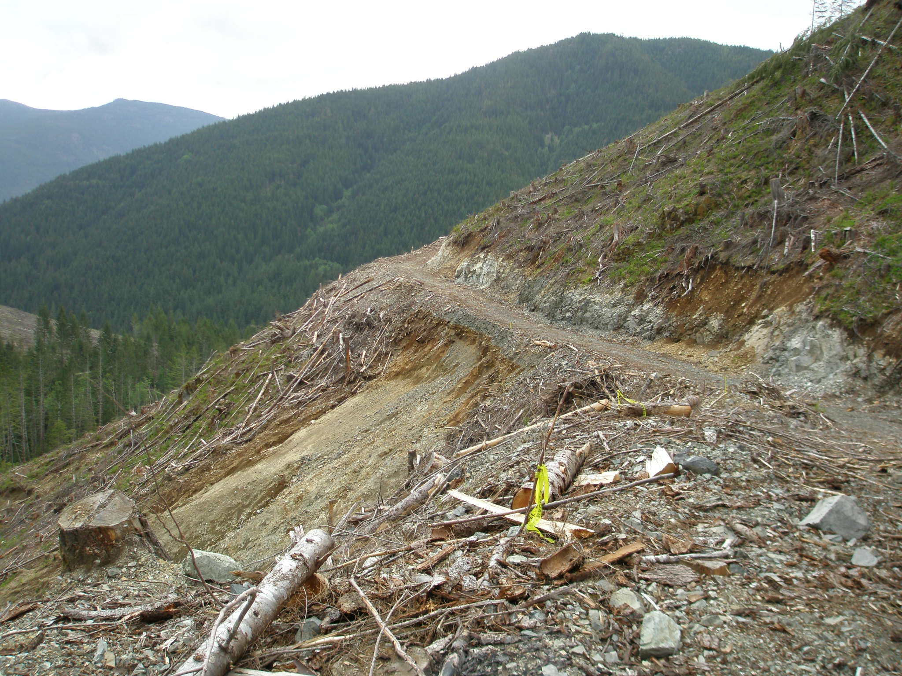
How does the Council enforce compliance?
Notes:
Council has the authority to convene a hearing that provides the Owner and affected parties with an ‘Opportunity to be Heard’
If a determination is made, Council has the legislative authority to prosecute non-compliance through the courts, administer penalties, issue remediation orders, stop work orders, or to enter into a consent agreements where there is agreement that a contravention may have occurred
Ultimately if the contravention is significant enough to warrant a landowner removed, Council could recommend to BC Assessment that the land be removed from the Managed Forest program

Slide 8
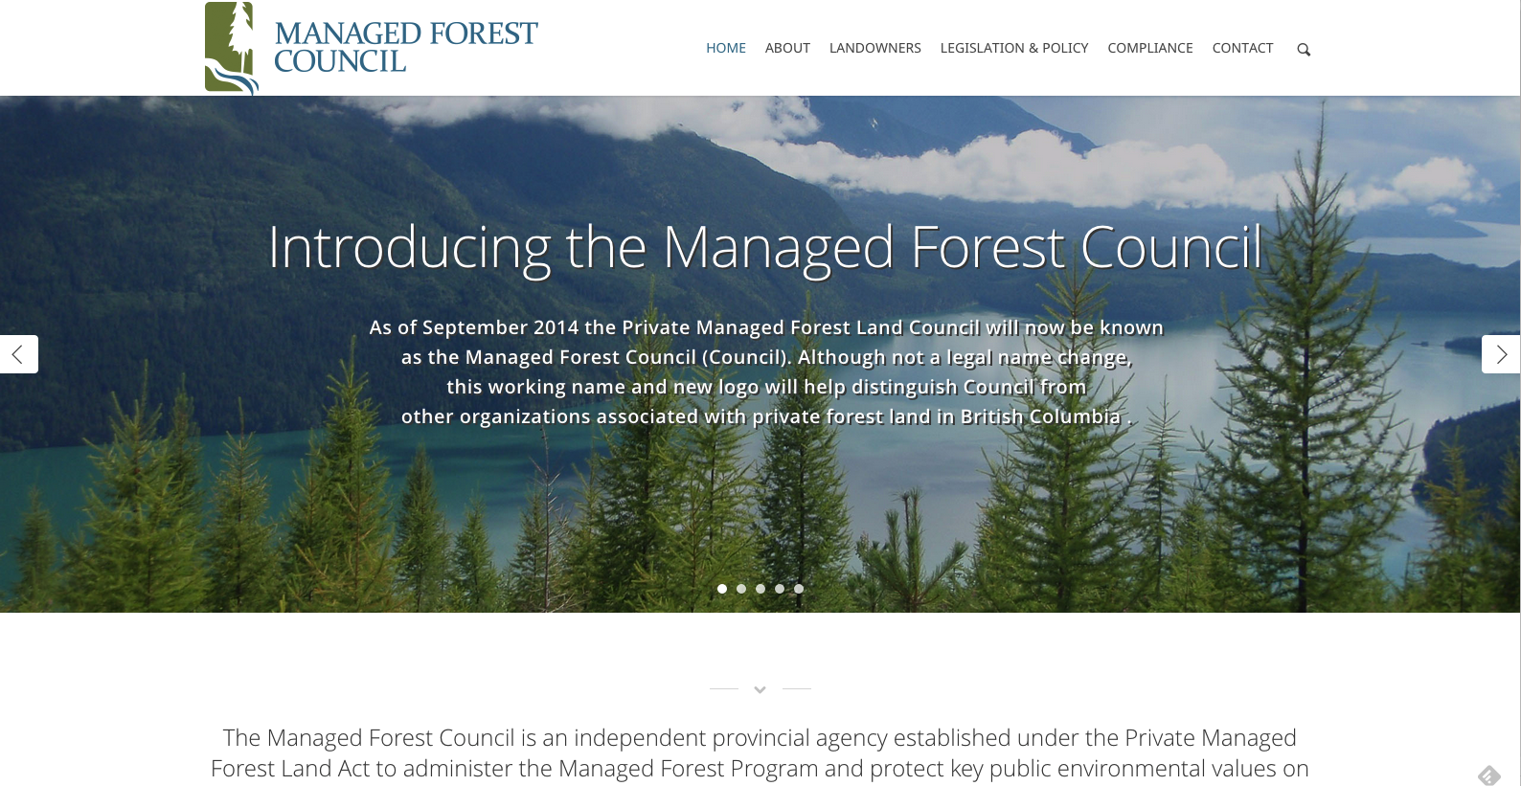

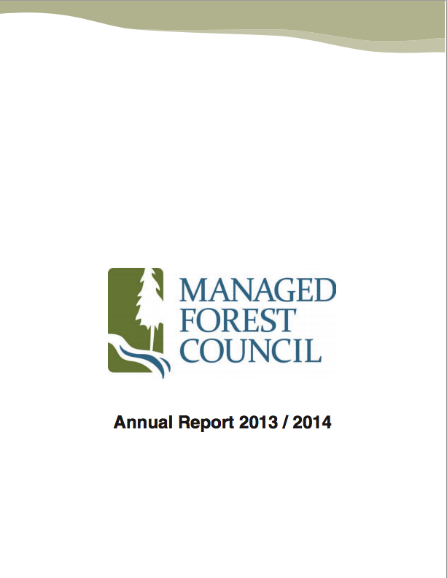
HOW DOES COUNCIL COMMUNICATE WITH STAKEHOLDERS AND THE PUBLIC?
Notes:
Annual Report to government and our Corporate Plan shared with public
Investigations, Audits and Reports shared with public
Website contains all this information
Council is subject to the Freedom of Information and Privacy Act
Meet with communities, stakeholders and all levels of government
Government recently announced a review of the private managed forest land program as part of the Coast Revitalization Initiative at the Truck Loggers convention

