Slide 1
Cowichan Watershed Board Meeting – Review of conditions at lake Cowichan
March 26, 2018,
Presentation by Brian Houle

Slide 2
Aerial view of Lake Cowichan Weir

Slide 3
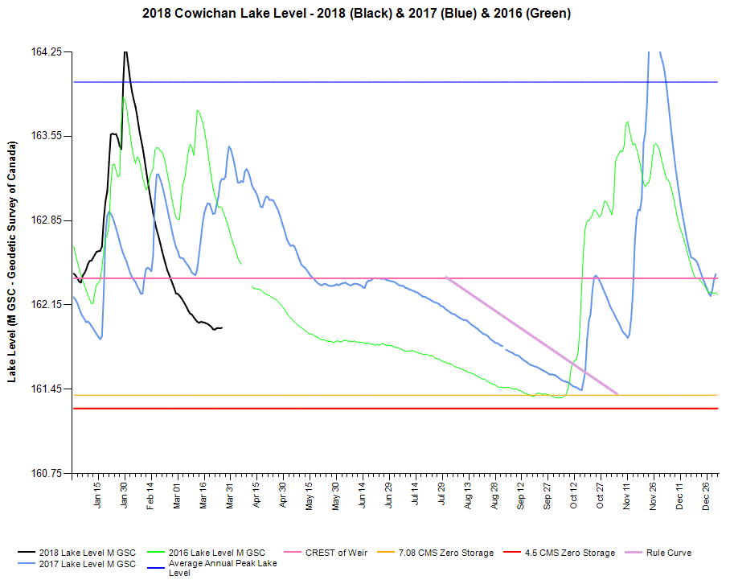
Lake level very low currently. Modest rainfall in recent days has resulted in a pause in rate of decline in lake level

Slide 4
Release of water from lake being controlled to seasonal target of 25 cms

Slide 5
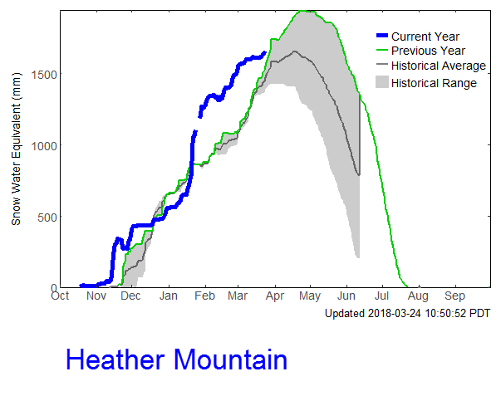
Heather Mountain snow pillow 2018 showing similar conditions as 2017 – very helpful

Slide 6
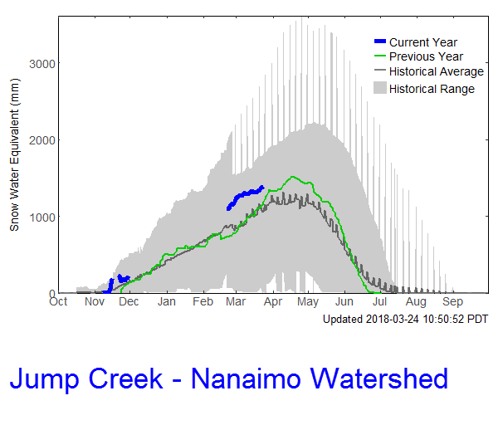
Jump Creek snow pillow showing similar situation as Heather Mtn: 2018=2017

Slide 7
Weather Forecast for coming 2 weeks does not indicate much rainfall

Slide 8
2018 Conditions
Boat Lock put into operation on March 21
Early storage of water in Lake Cowichan authorized and first gate actions to control release from lake at 25 cms taken on March 23
Snow pack meters indicating about same snow pack as 2017
Wet season (more rainfall) continues for about 1 more month and snow melt recharging lake level to follow that. 2018 has potential to support 25/15/7 cms minimum flow targets through to the return of rainfall this fall (depending on weather in April).

